Slide 1
State Board of Finance Investment Operation and Returns 2nd Quarter FY2021
Dennis Milligan
Arkansas Treasurer of State
Notes:
State Board of Finance Investment Operation and Returns, 3rd Quarter - 2019

Slide 2
Short-term Investment Revenue, Receipted
2nd Quarter FY 2021
Total: $961,078.29

Slide 3
Long-term Investment Revenue, Receipted 2nd Quarter FY 2021
Total: $7,429,033.36

Slide 4
Total Revenue per Quarter FY 16 – FY 21
$408 million total
Notes:
Fiscal Year 2016 through fiscal year 2019 quarterly total revenue comparison.

Slide 5
Treasury Portfolio Allocation *as of 12/31/2020
Share of Market Value Total

Slide 6
Money Management Earnings / Return on Investment FY17- FY21
Notes:
Fiscal year monthly comparison of money management balance and earnings.

Slide 7
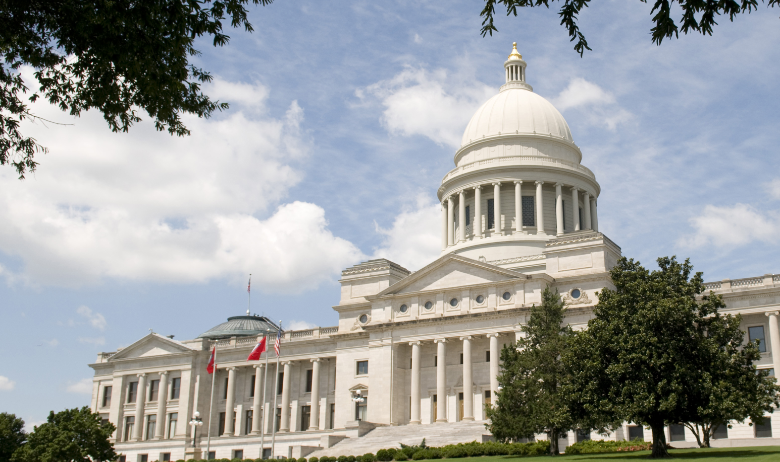
Notes:
State Board of Finance Investment Operation and Returns, 3rd Quarter - 2019

